Slide 1
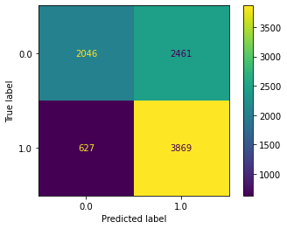
Executive Summary: Regression Analysis
TikTok claims classification project
The TikTok data team seeks to develop a machine learning model to assist in the classification of claims for user submissions. Earlier, the data team observed that if a user is verified, they are much more likely to post opinions. Since the end goal is to classify claims and opinions, it’s important to build a model that shows how to predict the behavior of the account type (verified) that tend to post more opinions. So, in this part of the project, the data team built a logistic regression model that predicts verified_status.
The variable of verified_status was selected for this regression model because of the relationship seen between the verified account type and the video content. A logistic regression model was selected because of the data type and distribution.
A LOOK AT THE MODEL RESULTS
The logistic regression model achieved a precision of 69% and a recall of 66% (weighted averages). This model achieved an f1 accuracy of 66%. These model results inform key insights on video features, discussed in “key insights.”
Based on the estimated model coefficients from the logistic regression, longer videos tend to be associated with higher odds of the user being verified.
Other video features have small estimated coefficients in the model, so their association with verified status seems to be small. As a result, other video features besides video length do not seem to be associated with verified status.
Confusion matrix for logistic regression model
The next step is to construct a classification model that will predict the status of claims made by users. That is the final project and original expectation from the TikTok team. Now, there is enough information to analyze the results of that model with helpful context around user behavior.
Upper-left: the number of videos posted by unverified accounts. Upper-right: the number of videos posted by unverified accounts. Lower-left: the number of videos posted by verified accounts. Lower-right: the number of videos posted by verified accounts.

